Slide 2
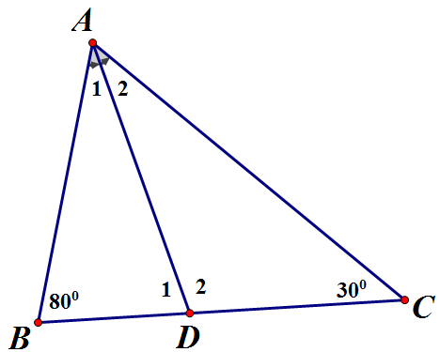
$$∆ABC$$
$↓$
$$\hat{BAC}+\hat{ACB}+\hat{CBA}={180}^{0}$$
$↓$
$\hat{BAC}$
$↓AD là phân giác \hat{BAC}$
$$\hat{A_{1}}=\hat{A_{2}}=\hat{BAC}:2$$
$↓$
$$\hat{D_{1}},\hat{D_{2}}$$

Slide 3
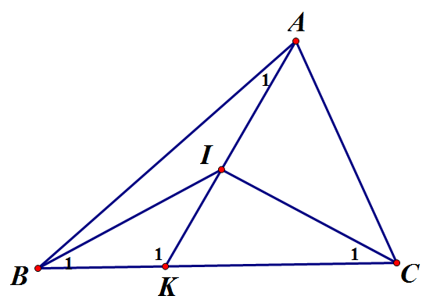
$$∆BIK$$
$↓$
$$\hat{B_{1}}+\hat{BIK}+\hat{K_{1}}={180}^{0}$$
$∆ABK$
$↓$
$$\hat{A_{1}}+\hat{ABK}+\hat{K_{1}}={180}^{0}$$
$$↓$$
$$\hat{BIK}={180}^{0}−(\hat{B_{1}}+\hat{K_{1}})$$
$$↓$$
$$\hat{A_{1}}={180}^{0}−(\hat{ABK}+\hat{K_{1}})$$

Slide 4
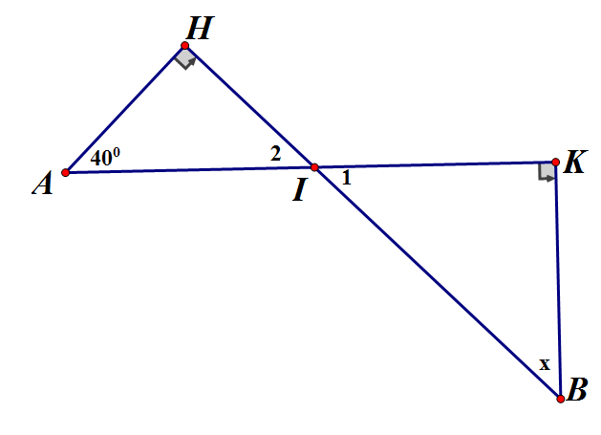
$$∆AHI$$
$$↑$$
$$\hat{I_{2}}$$
$$↑$$
$$\hat{I_{1}}$$
Trình bày
Suy nghĩ
$$↑$$
x

Slide 5
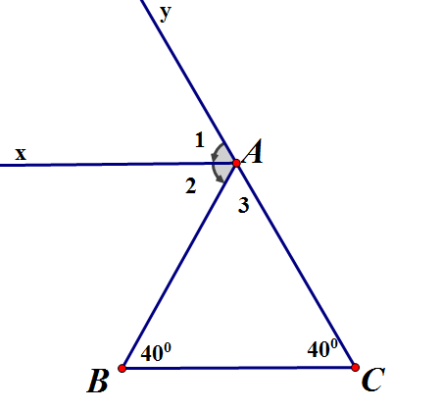
$$∆ABC$$
$$↑$$
$$\hat{yAB}$$
$$↑$$
$$\hat{A_{2}}$$
$$↑$$
$$\hat{A_{2}}=\hat{B}$$
Trình bày
Suy nghĩ
$$↑$$
Ax//BC

